Slide 1
My Project name computer center
SUMITTED BY
MD. Mushadur
IDB Consultant
Java & WPH
SUMITTED TO
Name: Nurnahar Moly
Round: 37
ID : 1243613

Slide 2
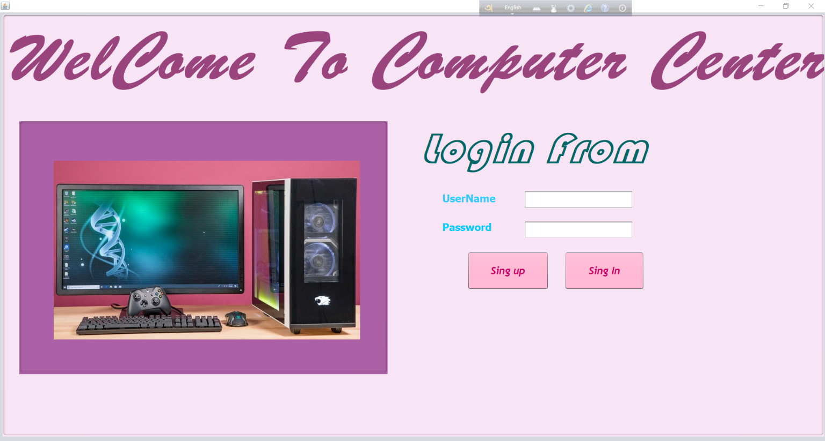
Login Page

Slide 3
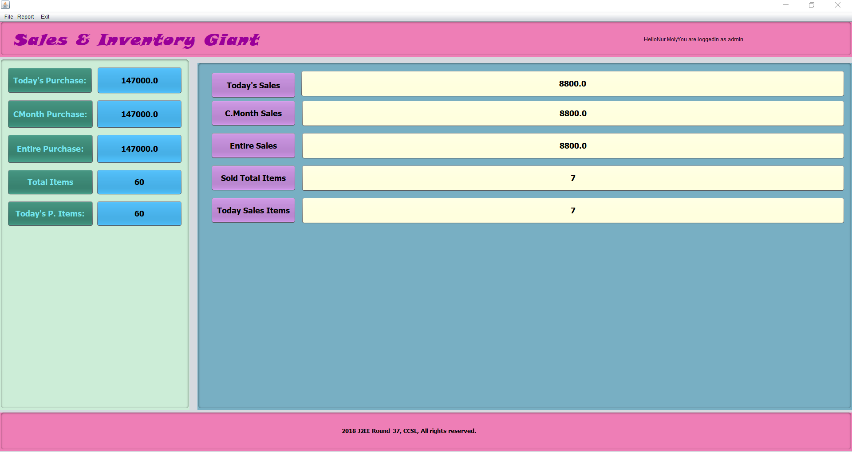

Slide 4
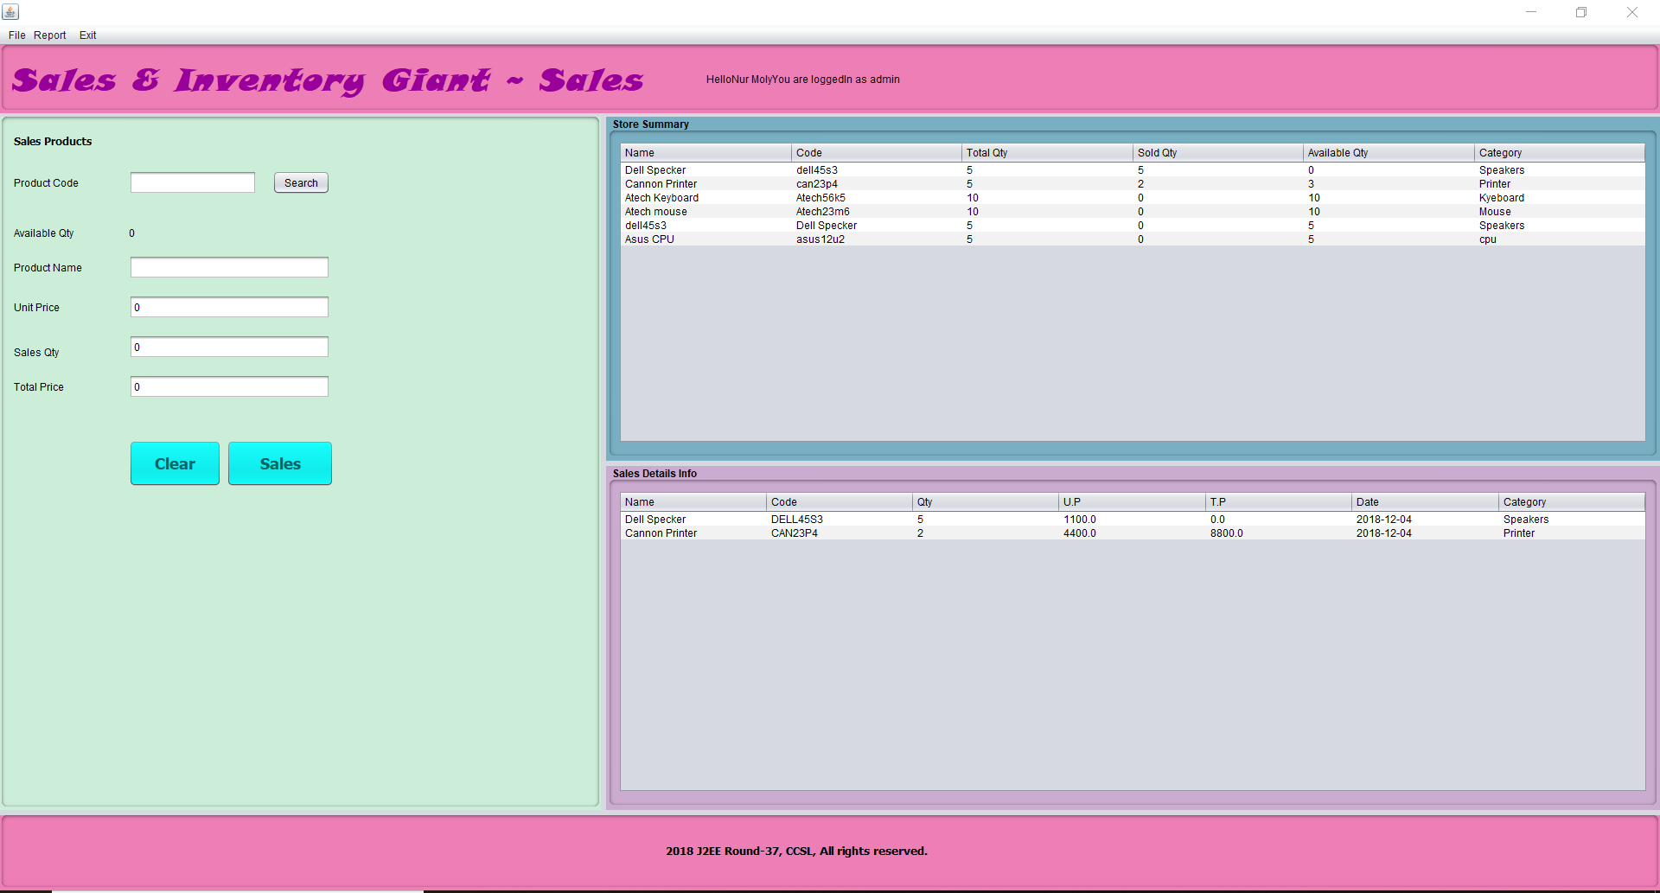

Slide 6
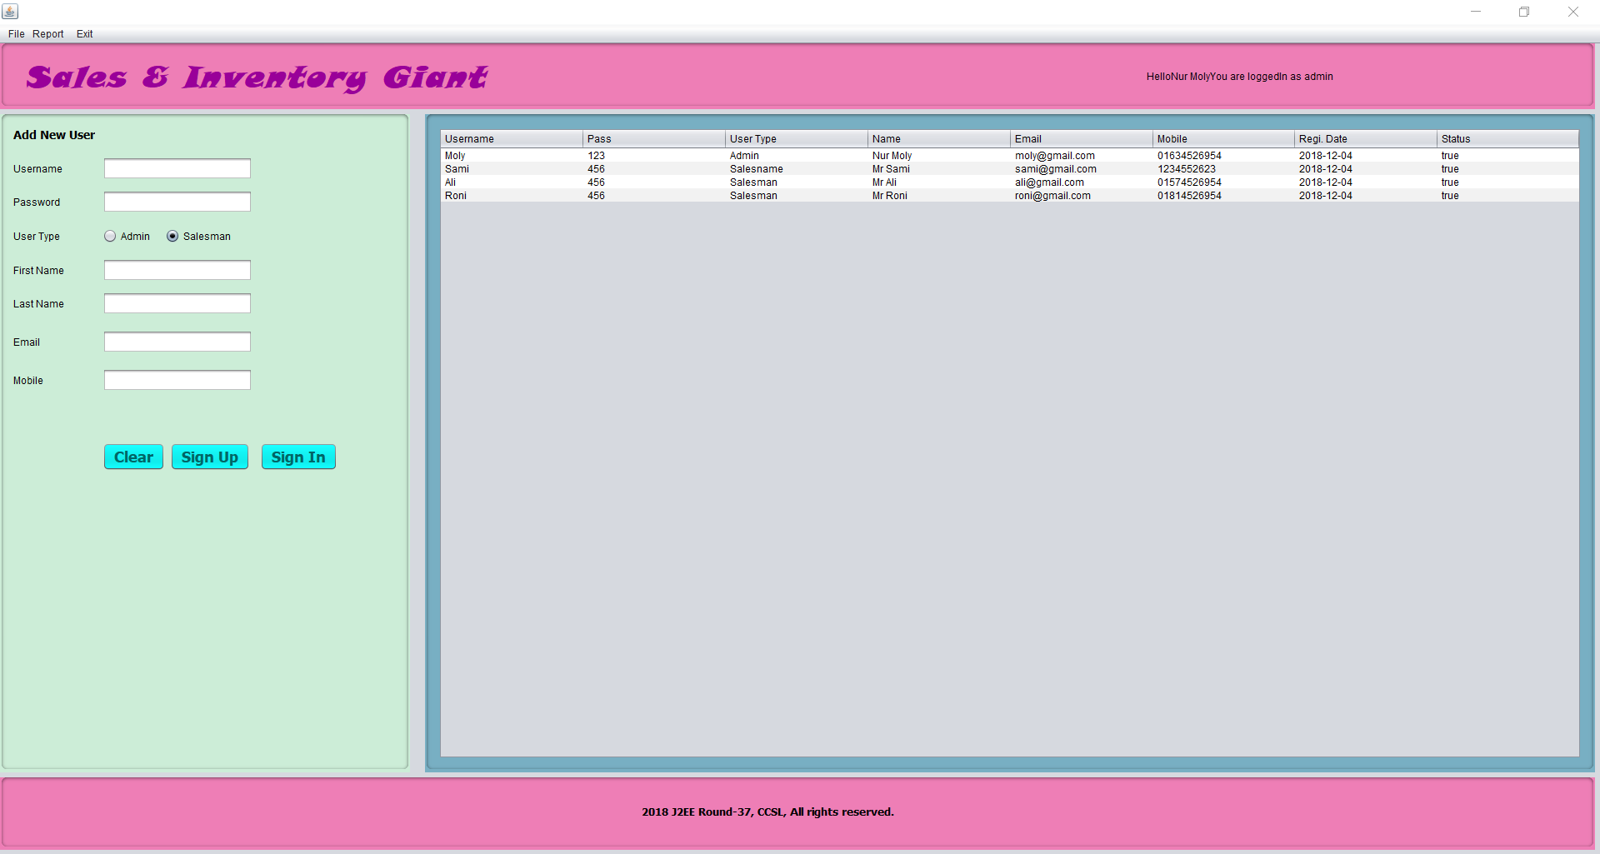

Slide 7
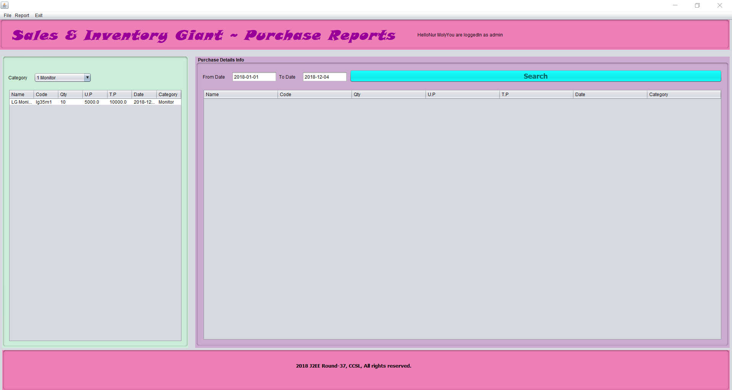

Slide 8
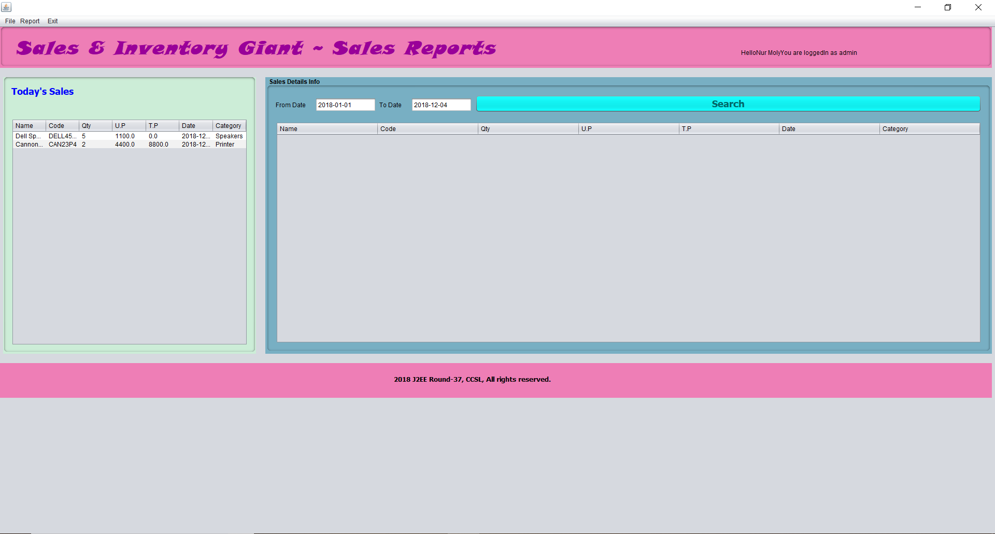

Slide 9
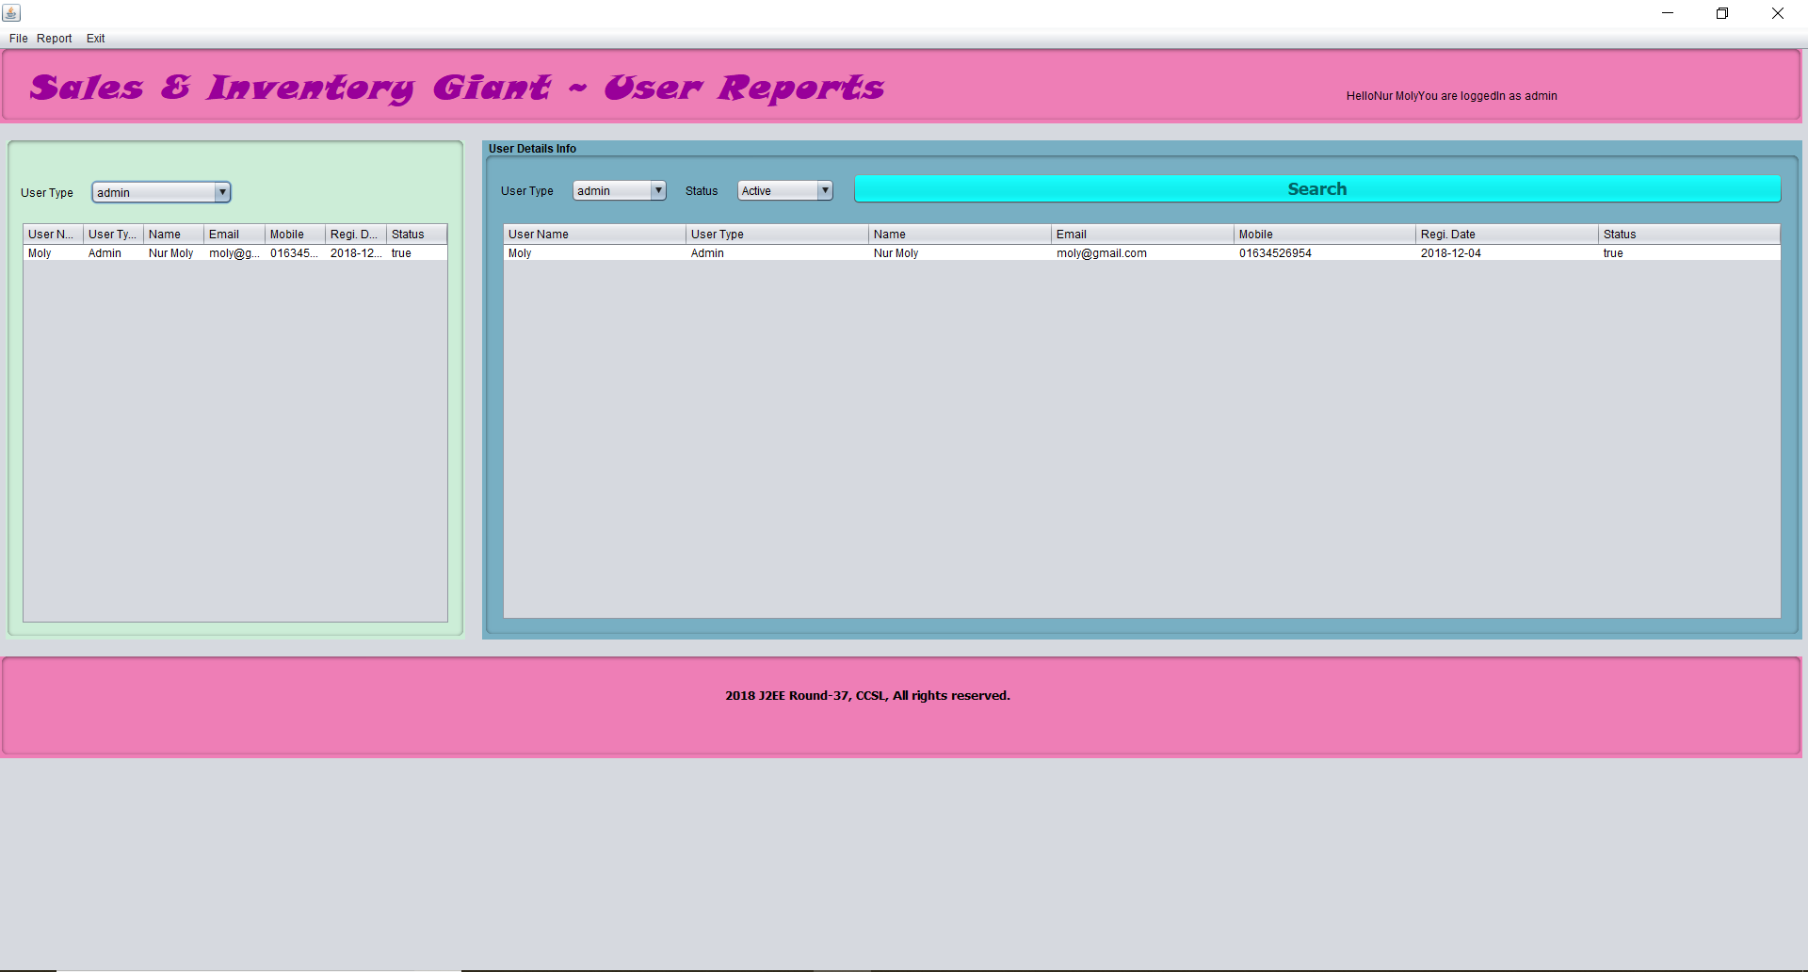

Slide 10
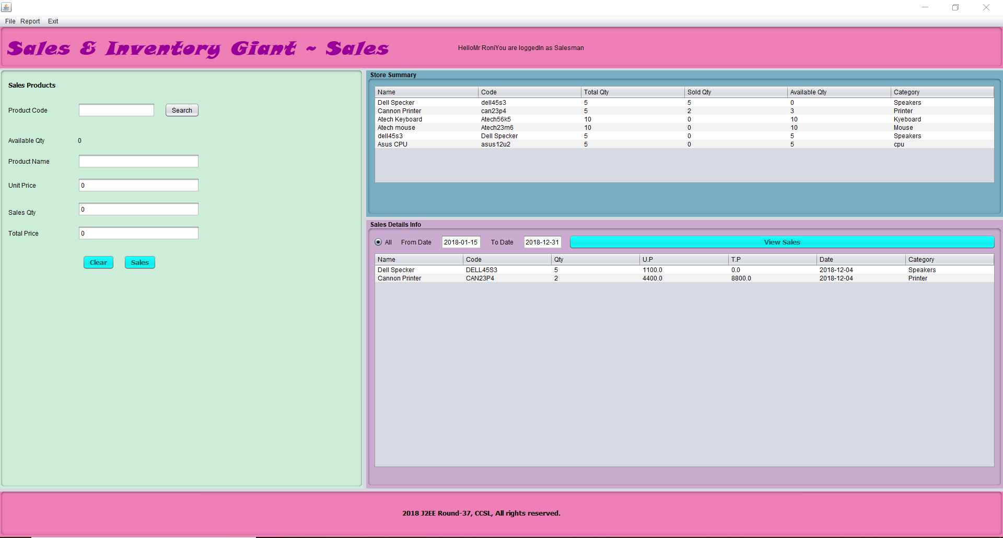

Slide 11
Thank You for Watching

